Slide 1

The Power of Quantum Neural Networks
Rajesh Sathya Kumar

Slide 2
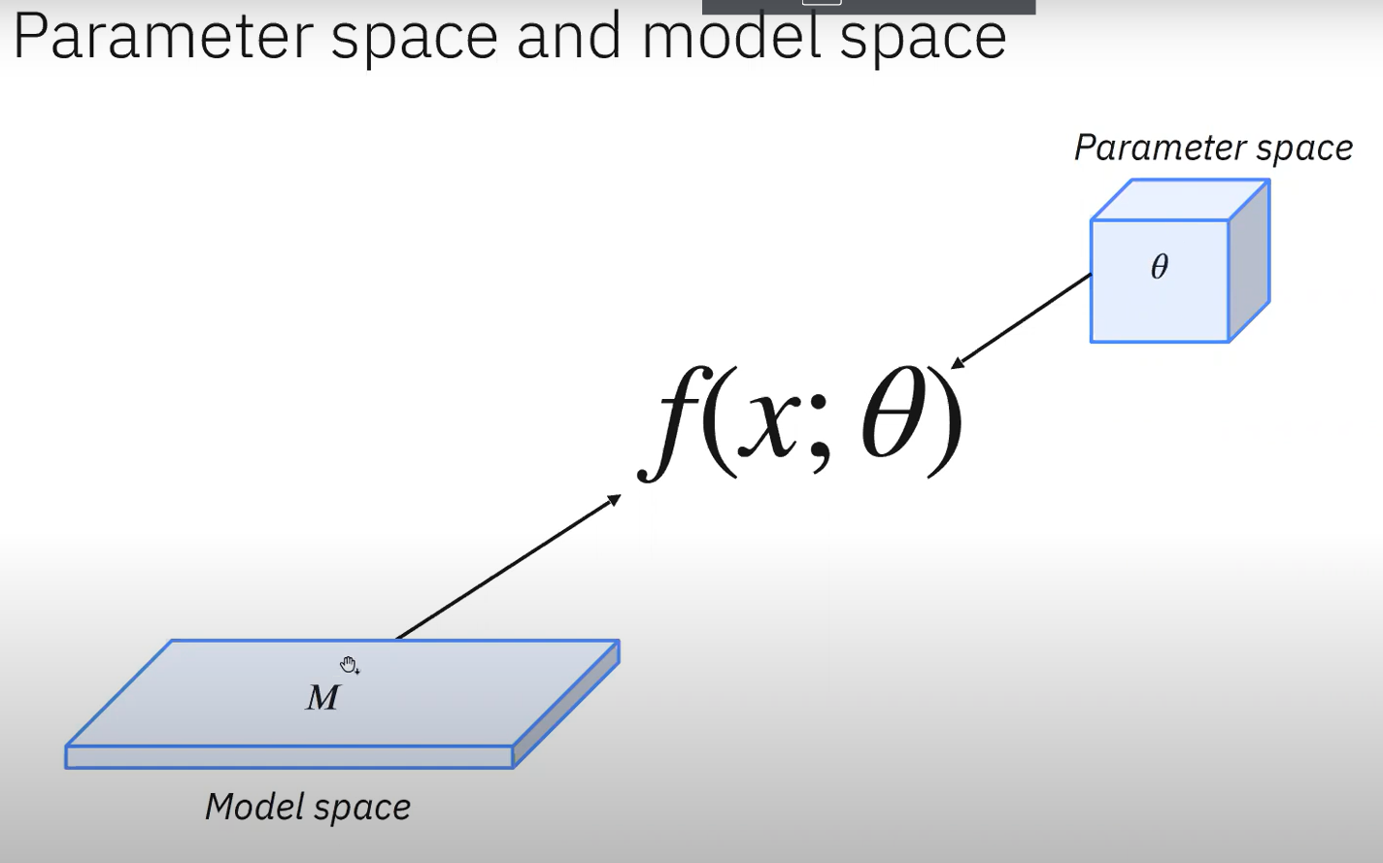
Parameter Space vs Model Space

Slide 3
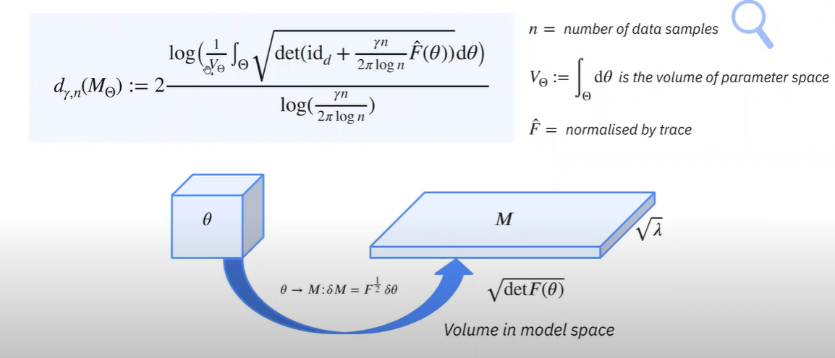
Effective Dimension
Effective dimension determines the effectiveness of our models. It gives us a sense of irrelevant features,
flat landscapes, etc.
Bereznuik et al. “A scale-dependent notion of effective dimension” arXiv preprint arXiv: 2001.10872 (2020)

Slide 4
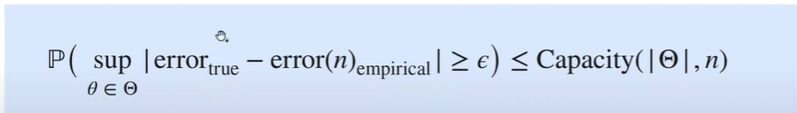
Effective Dimension and Generalization
Generalization Error
We want to make statements about the performance of a model on unseen data
A capacity measure can help give information about the generalization error by way of a generalization bound

Slide 5
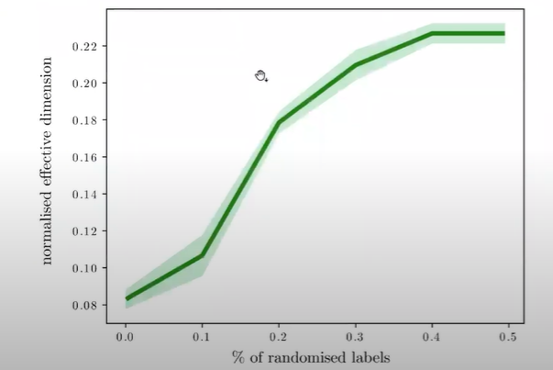
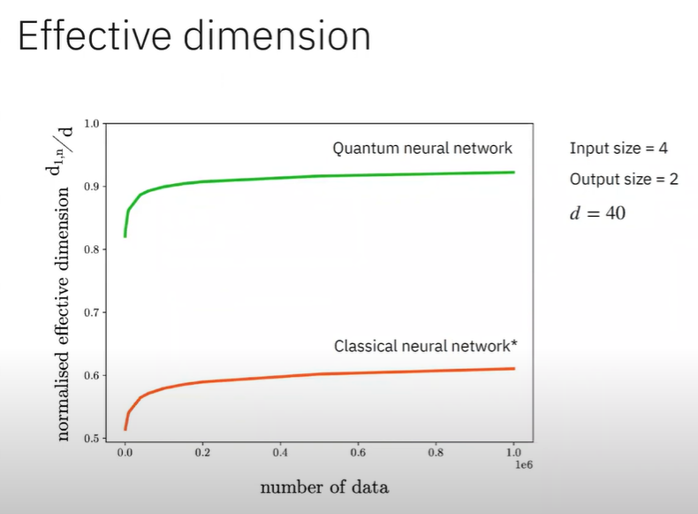
Generalization of Effective Dimension
Fig 1
Fig 2
Fig 1 and 2 cited from: Abbas, A., Sutter, D., Zoufal, C. et al. The power of quantum neural networks. Nat Comput Sci 1, 403–409 (2021). https://doi.org/10.1038/s43588-021-00084-1

Slide 6
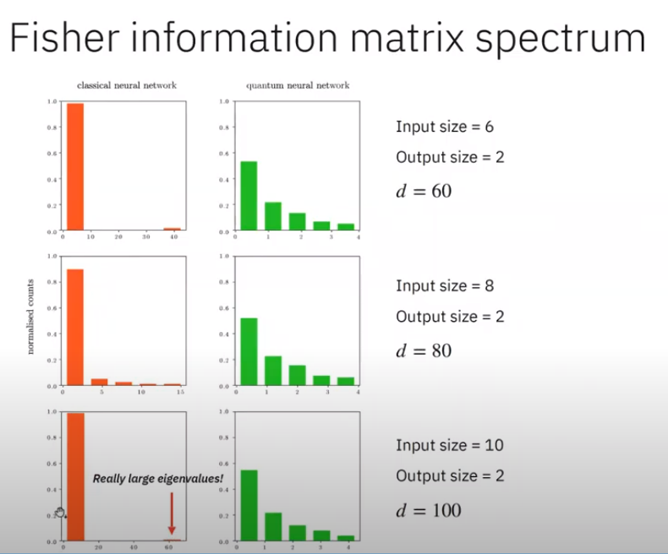
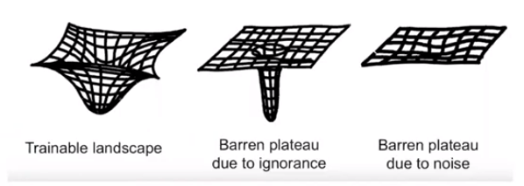
Fisher Information Matrix Spectrum
The Fisher information is a way of measuring the amount of information that an observable random variable X carries about an unknown parameter theta upon which the probability of X depends. (Source: Wikipedia)
Fig 3: Trainable Landscape [1]
Fig 4: Fisher Information Matrix Histogram

Slide 7
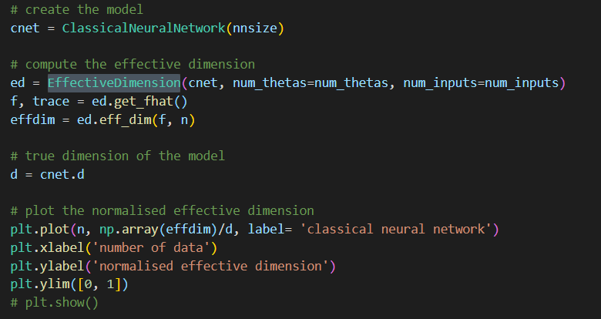
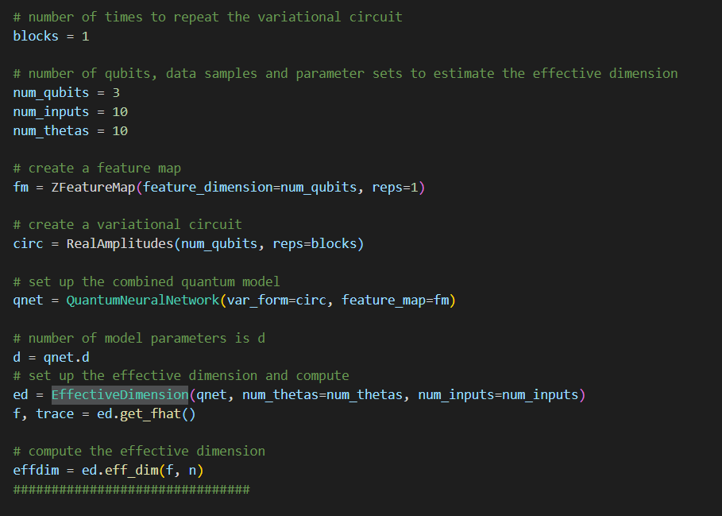
Example CNN and QNN
Modelling CNN
Modelling QNN

Slide 8
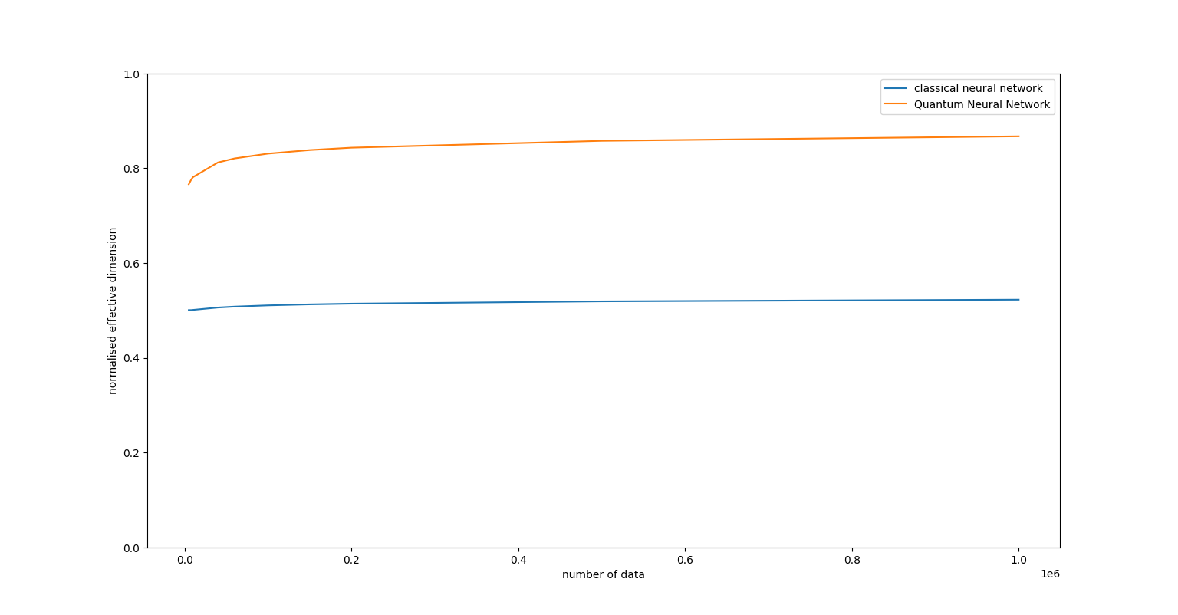
Effective Dimension Plot

Slide 9
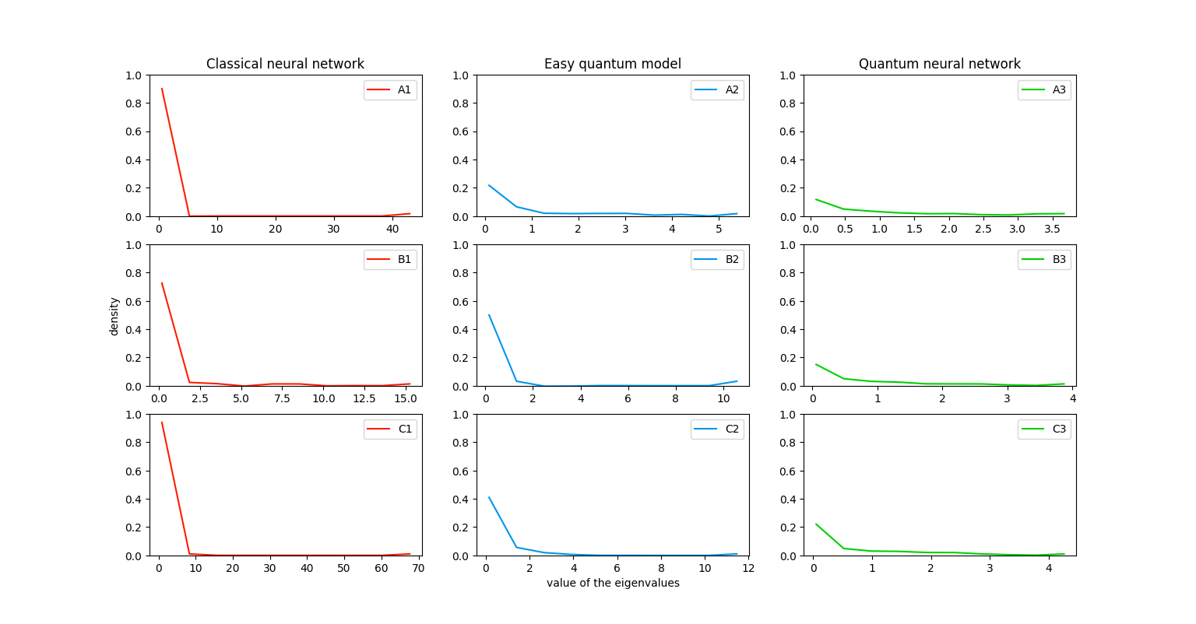
Eigen Value Histogram Plot

Slide 10
Reference
[1] Abbas, A., Sutter, D., Zoufal, C. et al. The power of quantum neural networks. Nat Comput Sci 1, 403–409 (2021). https://doi.org/10.1038/s43588-021-00084-1

Slide 11
Progress
While I am looking into various references for measuring quantum volume for quantum neural networks, Effective dimension is a very good measure in quantifying the effectiveness of the quantum models. On the next steps,
I will be working on coding the effective dimension measure
I am learning more on Error Mitigation as well.

